Slide 1
Games for Design Research and Education Workshop
E. Bayrak, P. Grogan, J. Luo, B. Mesmer, T. Pedro, Y. Ren, Z. Sha, M. Shergadwala, E. Starkey, A. Vasconcelos, B. Yan, and other players
Design Computing and Cognition Conference
Northwestern University, Evanston, IL (Jun. 25, 2016)

Slide 2
Agenda
Presentations (2:15pm - 4:00pm)
Paul Grogan - Stevens Institute
Bowen Yan - Singapore University of Technology and Design
Zhenghui Sha - Northwestern University
Tiago Pedro - Instituto Universitario de Lisboa
Maria Adriana Neroni - University of Cambridge
Murtuza Shergad - Purdue University
Bryan Mesmer - University of Alabama, Huntsville
Please help by actually playing the games
Group discussion (4:10pm - 4:55pm)
What design challenges can get benefit from human “knowledge” and “creativity”?
What human “knowledge” and “creativity” can be learned through game plays?
How game mechanism affects human behavior and design results?
How to document both successes and failures in the development of gamification?
Please think about these questions while you play the games.
We appreciate critical comments☺

Slide 3
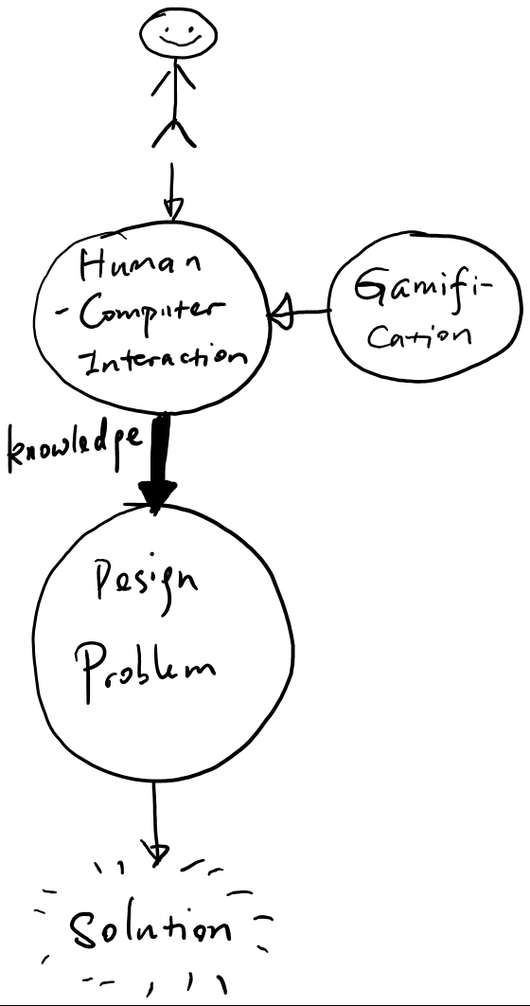
Design Gamification
How does gamification change the “knowledge” or “creativity”?
How does the change in “knowledge” or “creativity” change the quality of the solution?

Slide 4
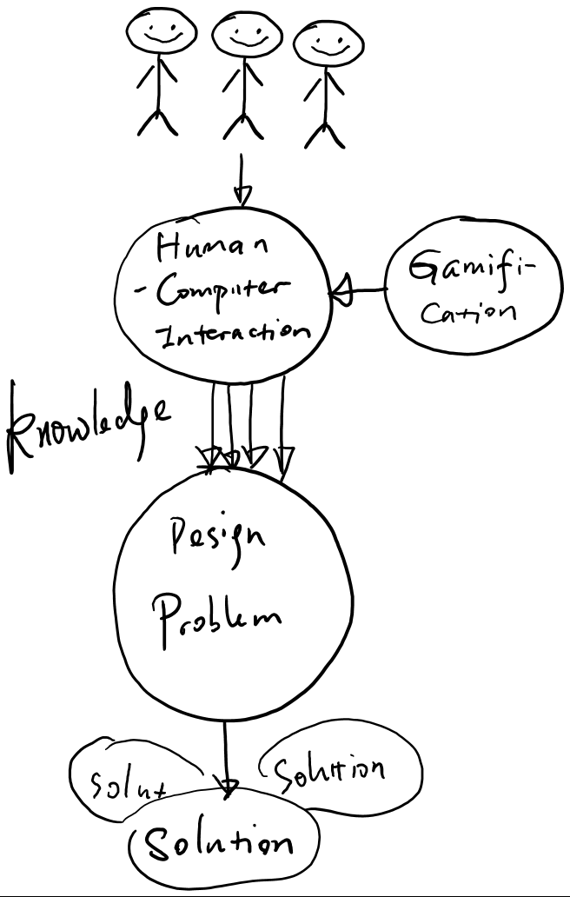
Design Gamification
How does gamification change the crowd?
How does the change in the crowd change the quality of the solution?

Slide 5
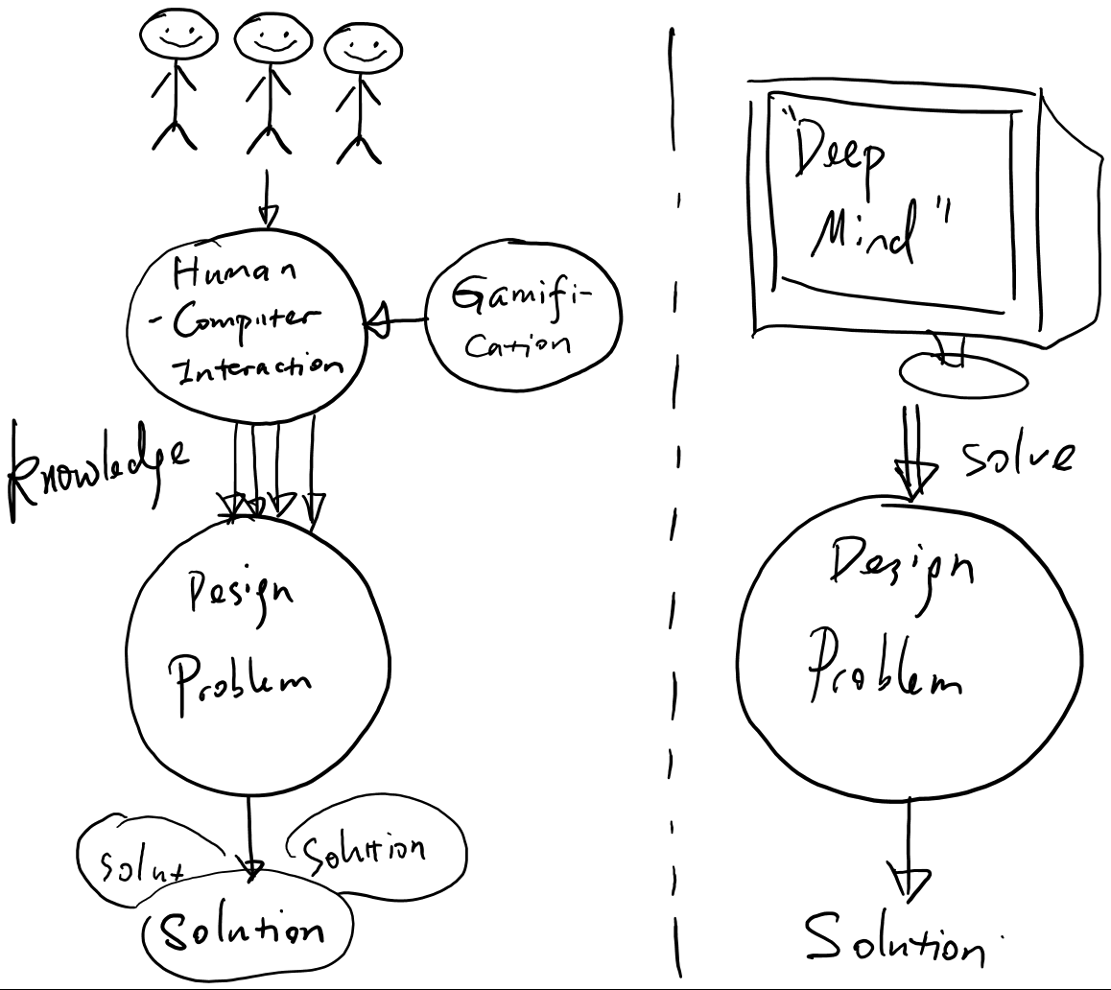
Design Gamification
Baseline for validation: Computational solution

Slide 6
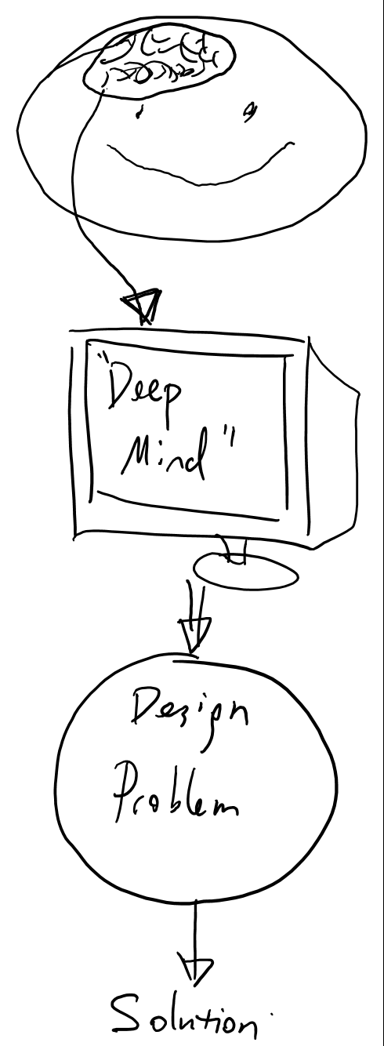
Design Gamification
Knowledge and creativity are being studied and modeled
E.g., Dopamine release for human learning <-> reinforcement learning alg.
Visual cortex <-> Deep neural network

Slide 7
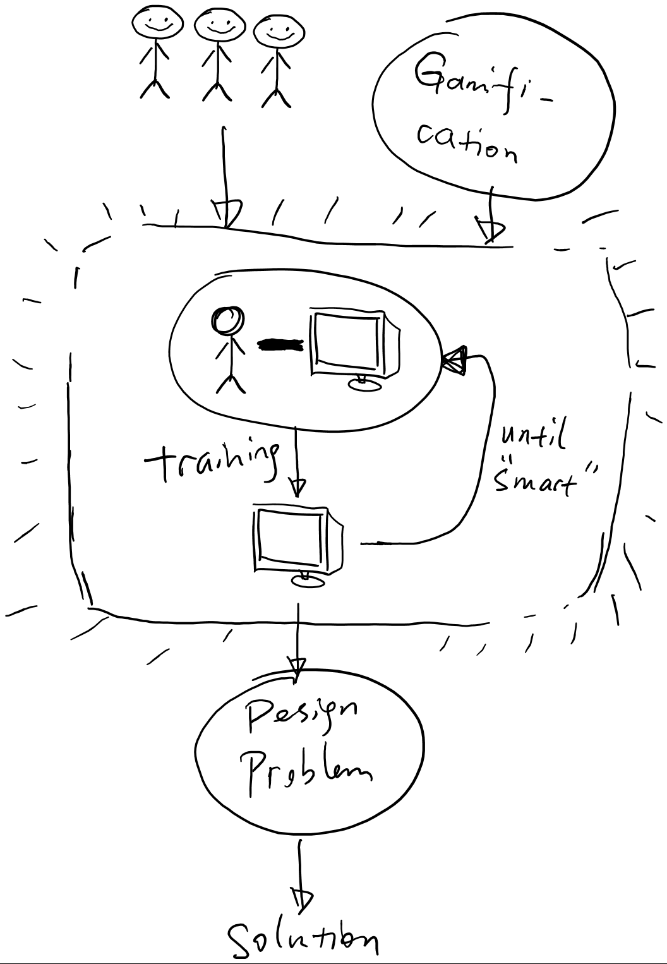
Design Gamification
Opinion: Human plays the role of helping a computer to get better at solving design problems
Gamification helps train the algorithm.

Slide 8
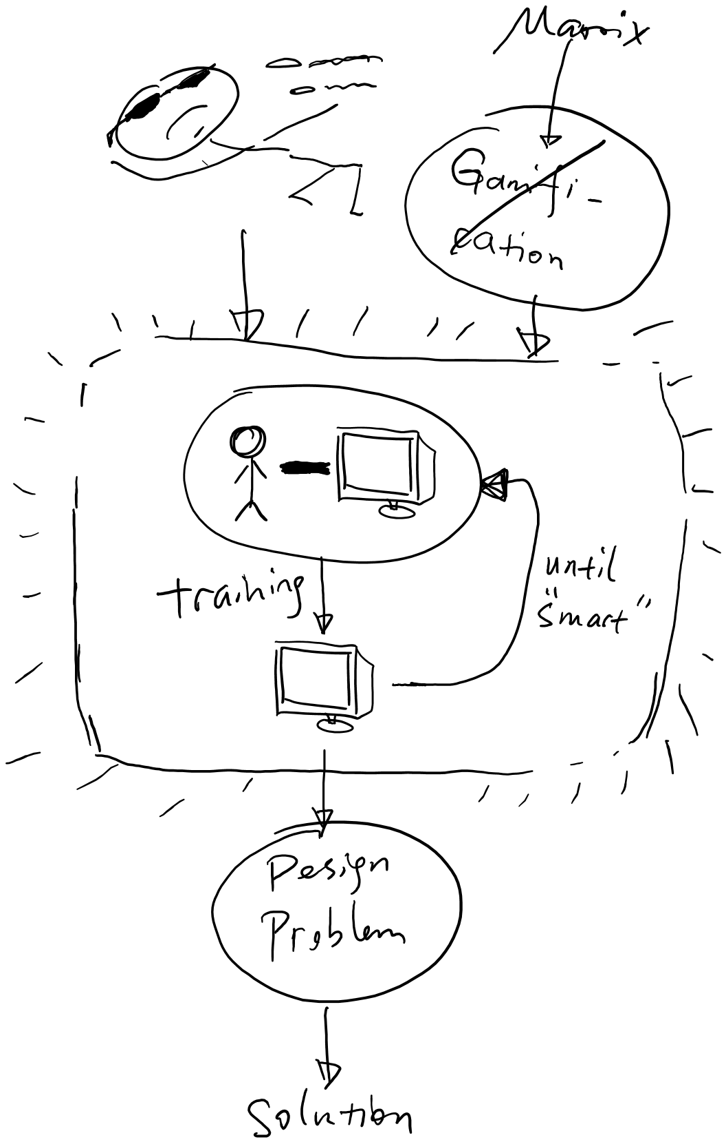
Design Gamification
Opinion: Human plays the role of helping a computer to get better at solving design problems
Gamification helps train the algorithm.

Slide 9
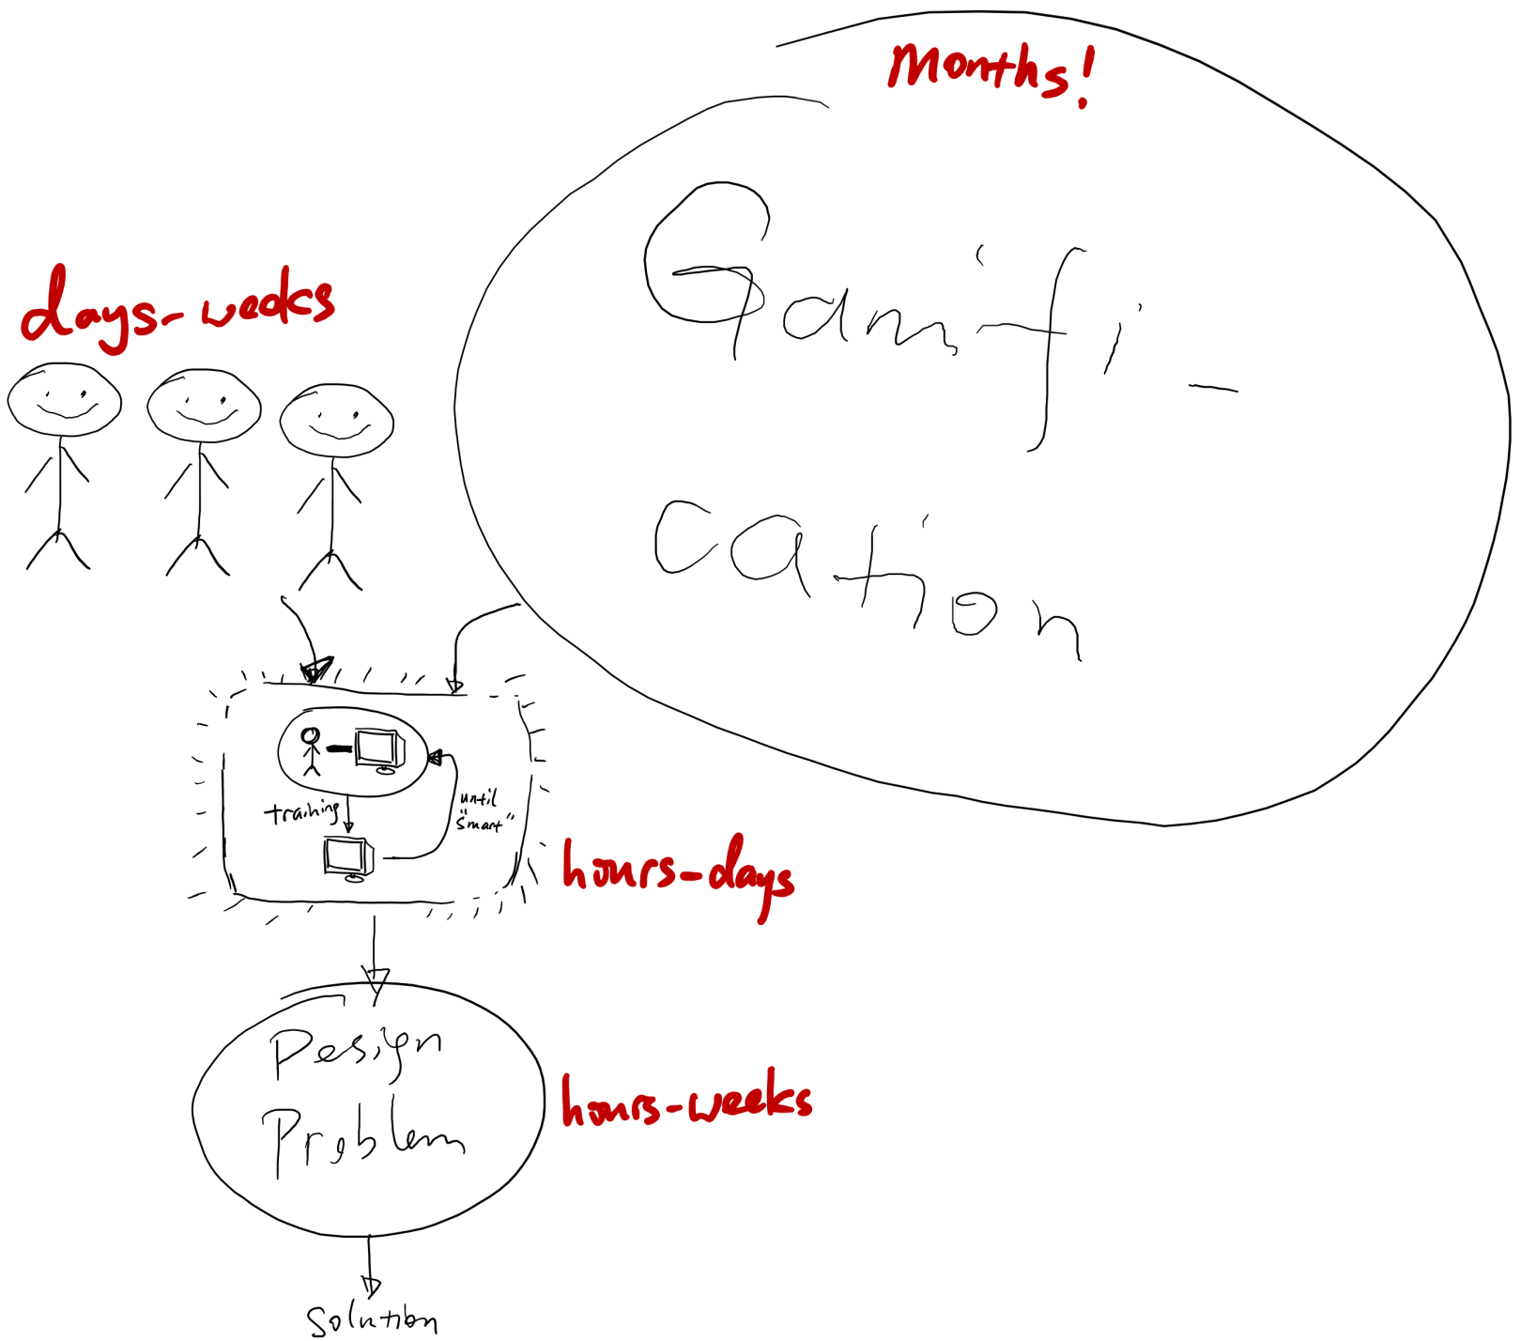
Design Gamification
Gamification can be costly!

Slide 10
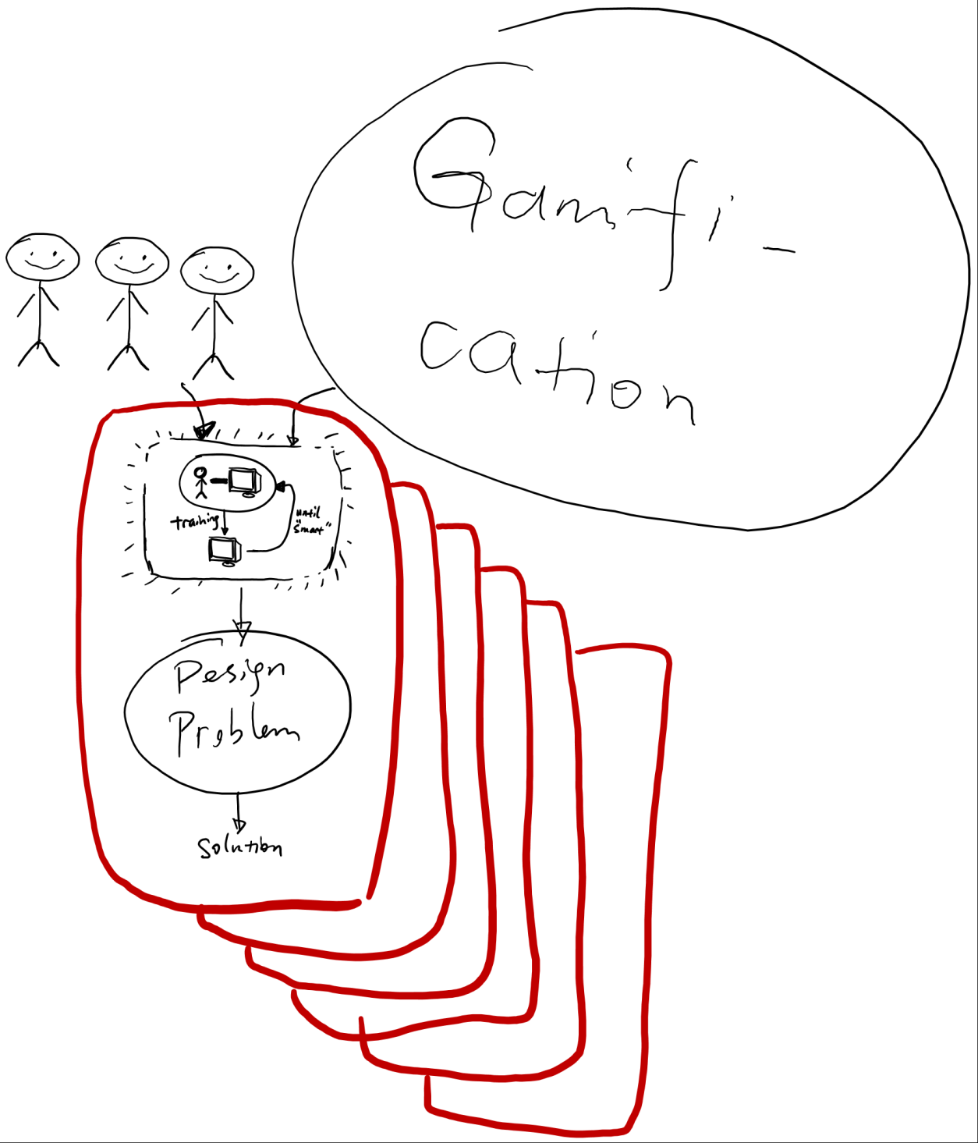
Design Gamification
Opinion: Justification of gamification:
Gamification is necessary (for what?)
One gamification implementation can speed up algorithms for a large number of problems

Slide 11
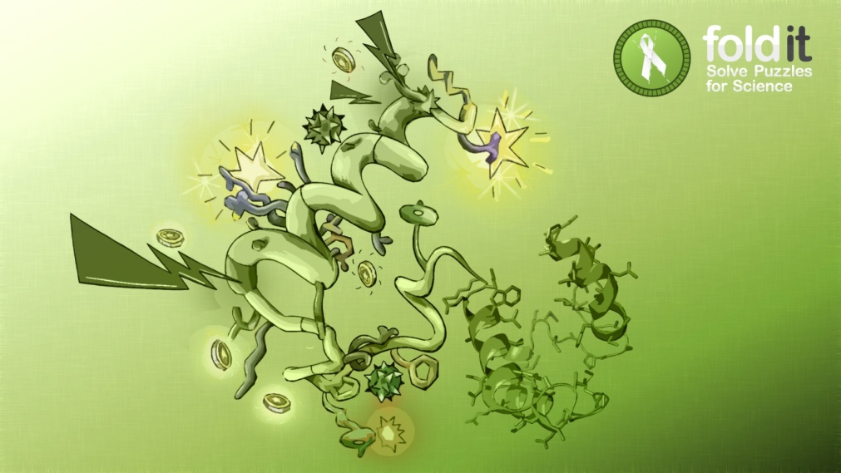
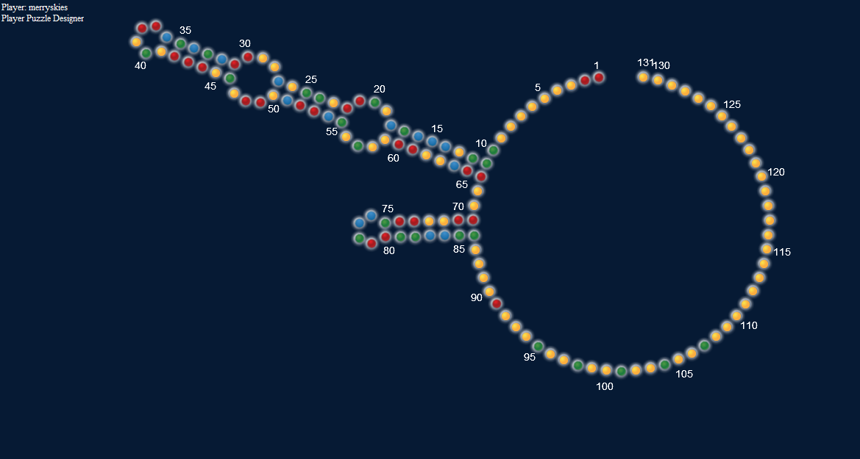
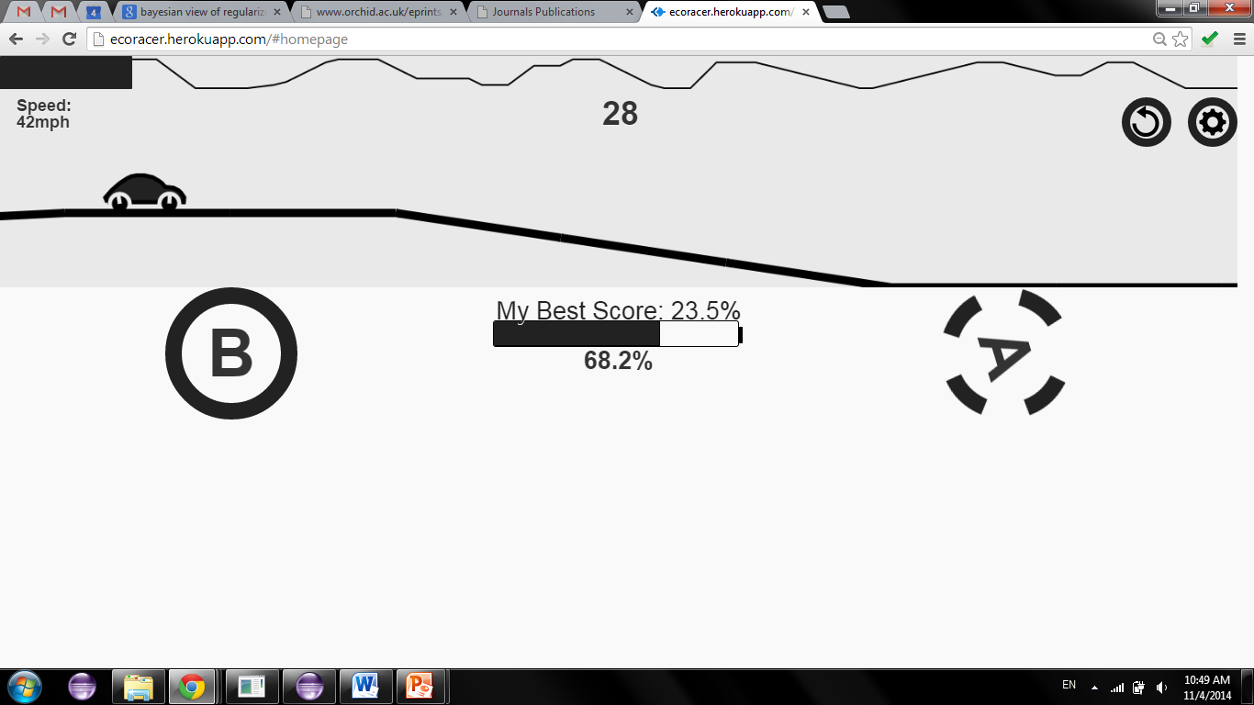
My Gamification Experience
Can human beings achieve higher convergence rate in solving NP problems than a computer solver?
eteRNA
ecoracer.herokuapp.com

Slide 12
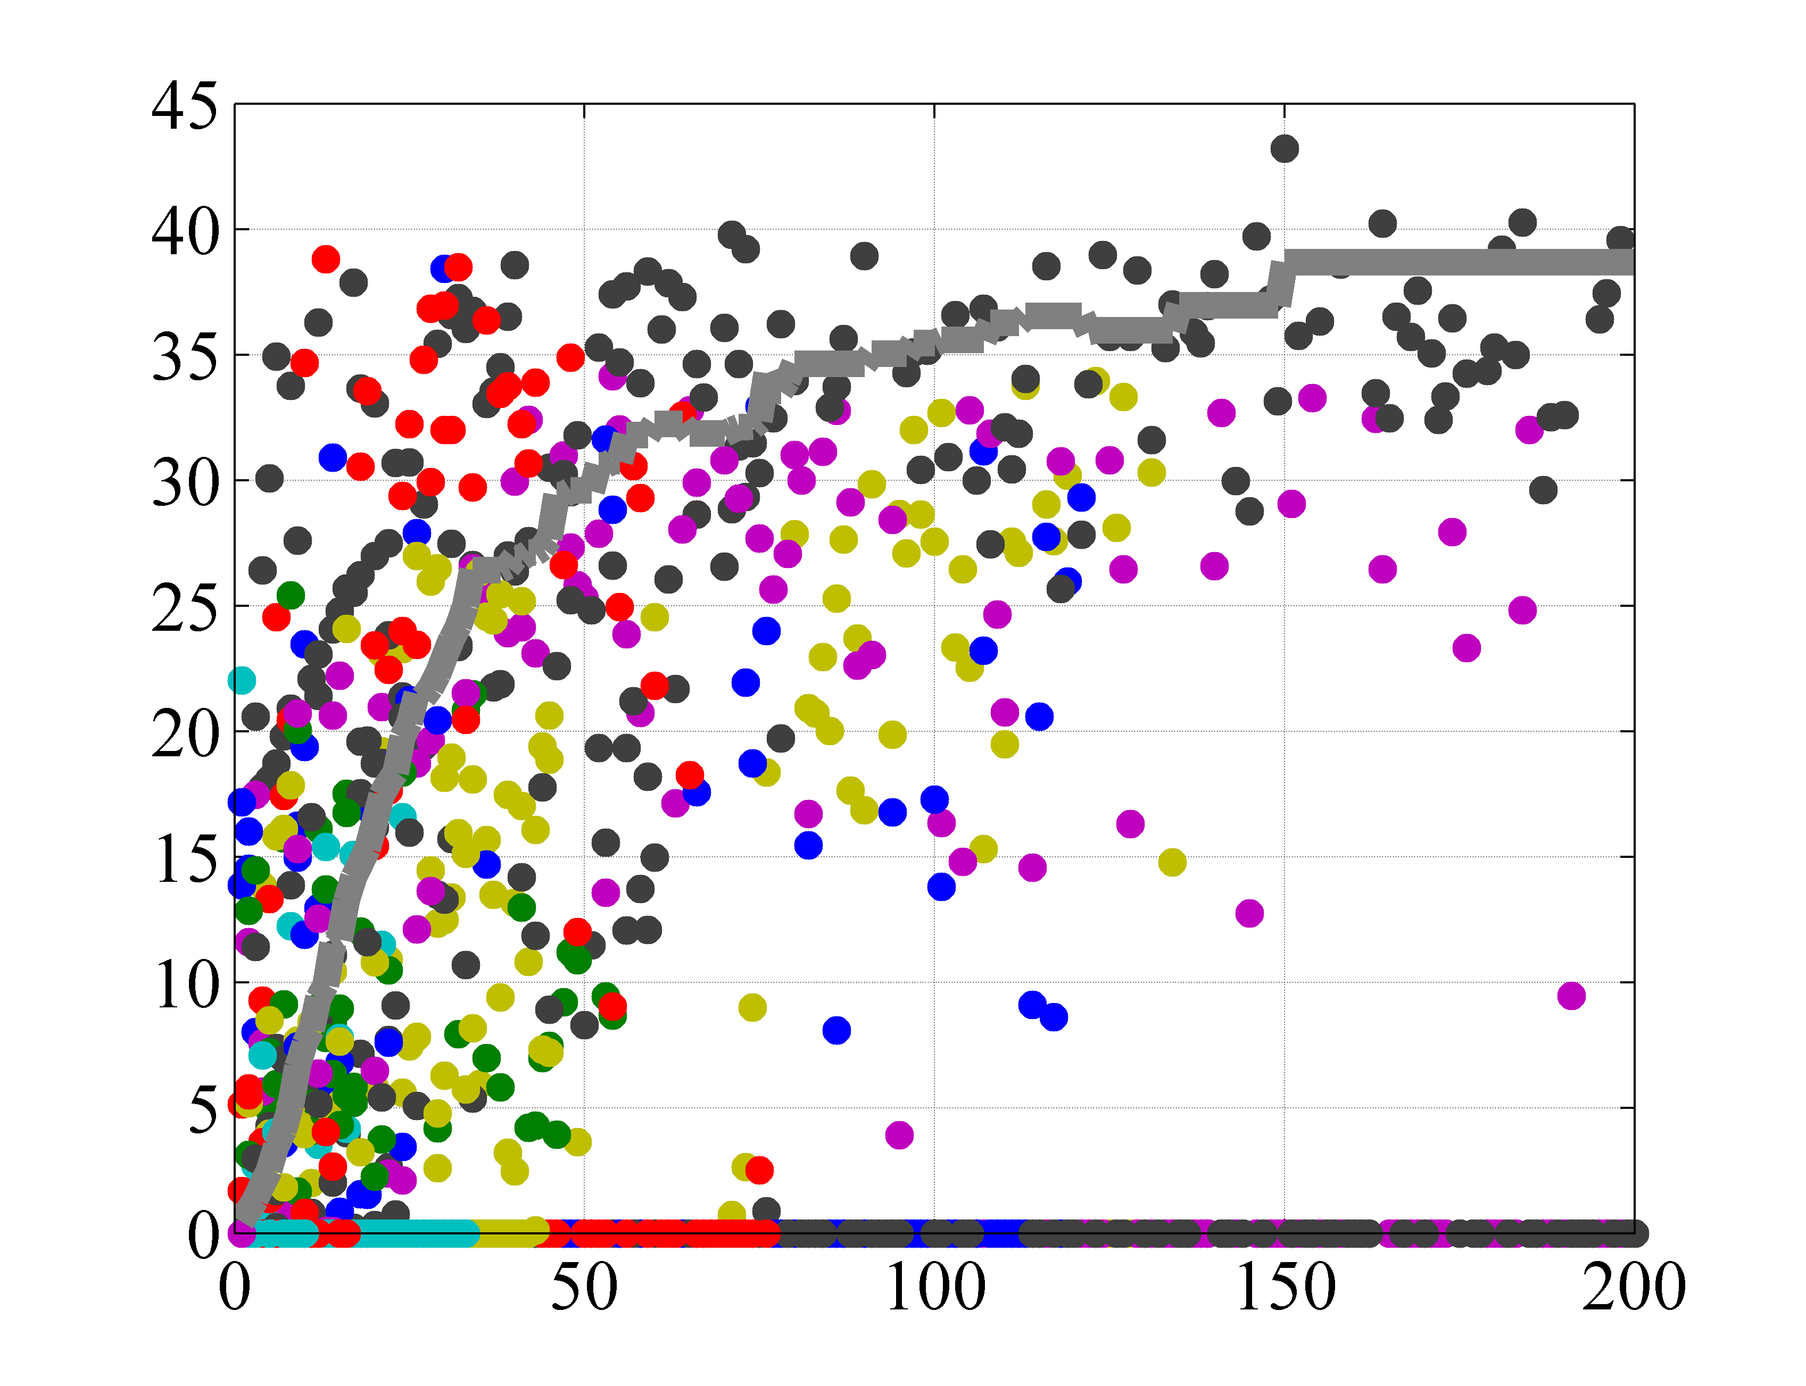
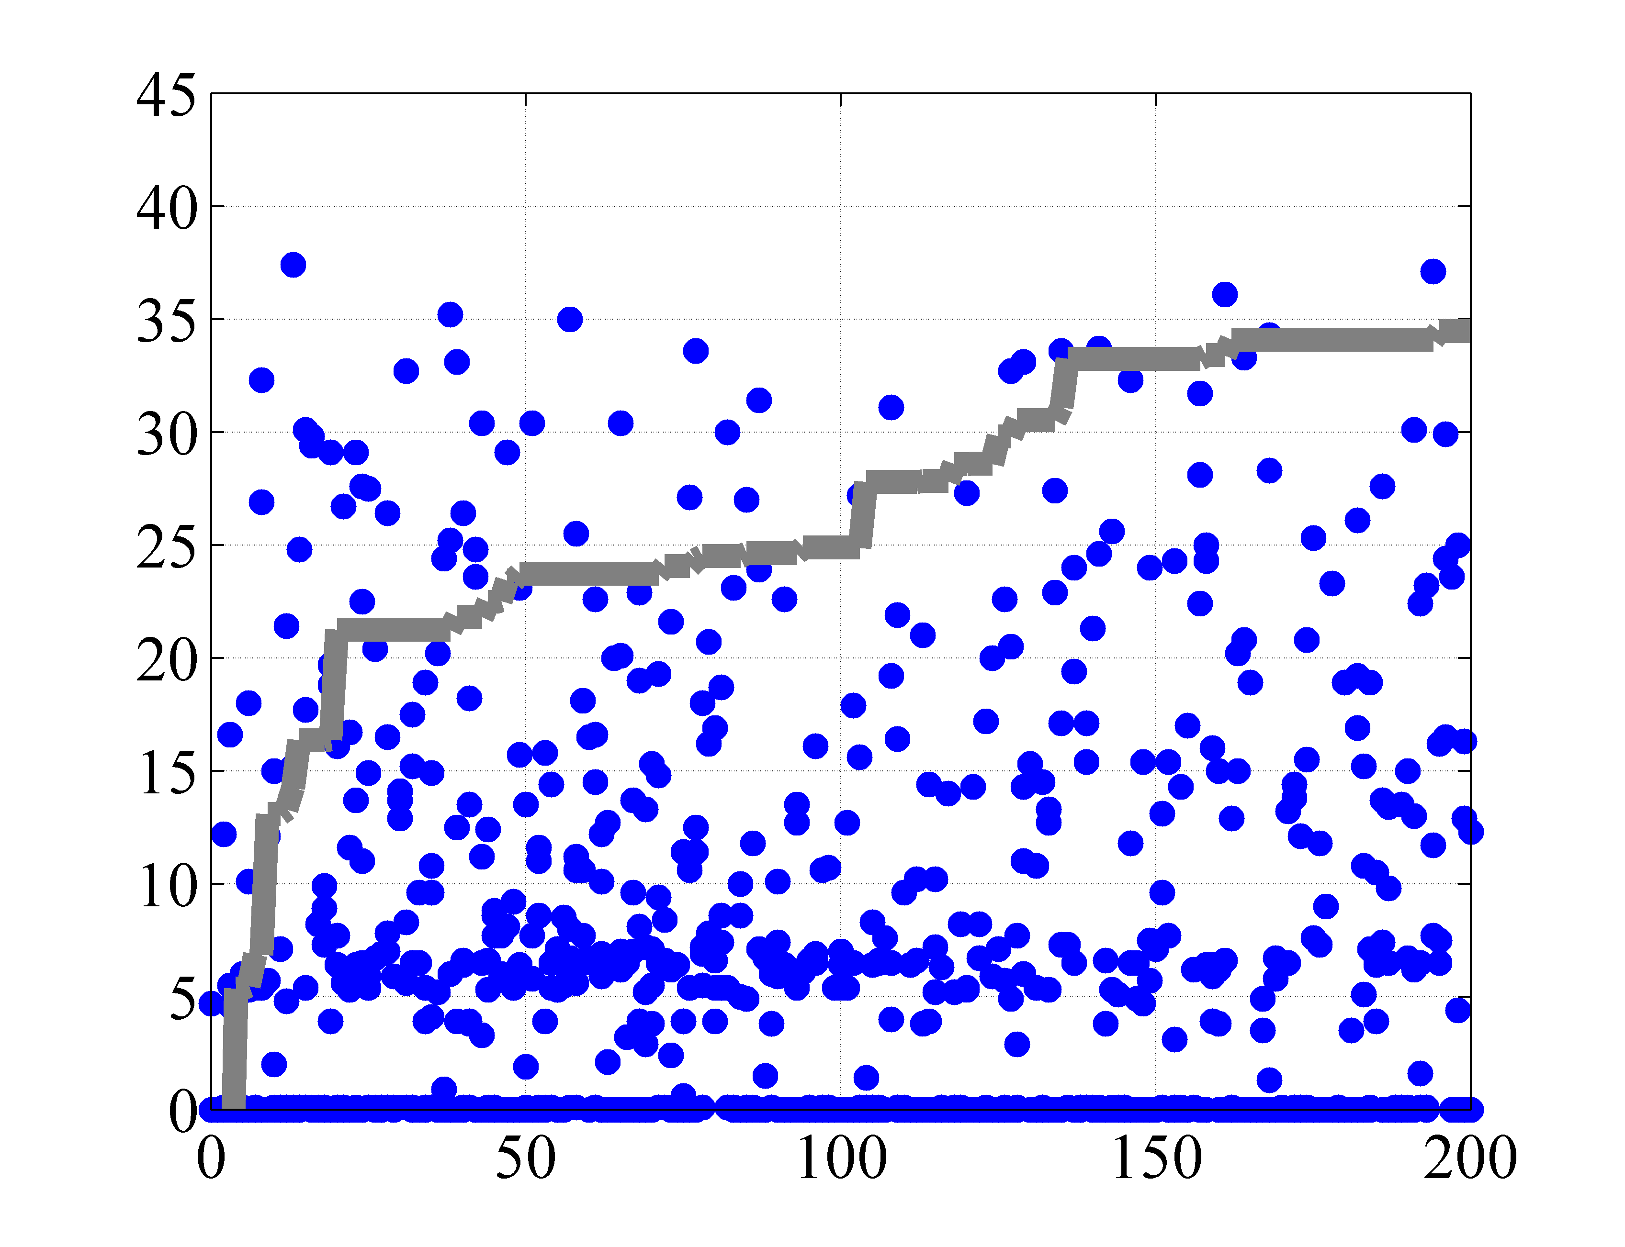
My Gamification Experience
Can human beings achieve higher convergence rate in solving NP problems than a computer solver?
Best player score: 43.2%
DP score: 43.8%
Best EGO score: 37.1%
avg. best score
Score
avg. best score
Number of plays (by human)
Number of plays (by EGO)

Slide 13
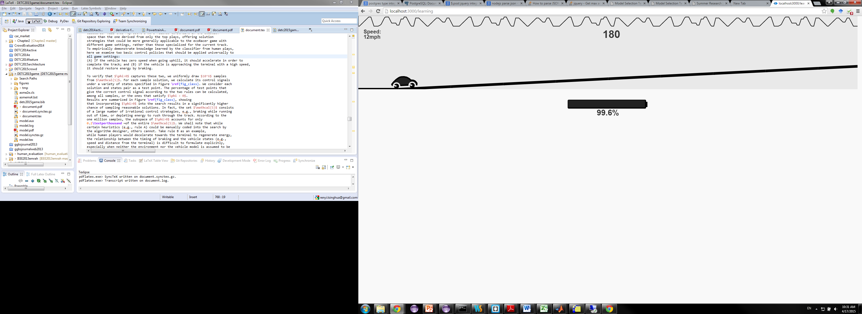
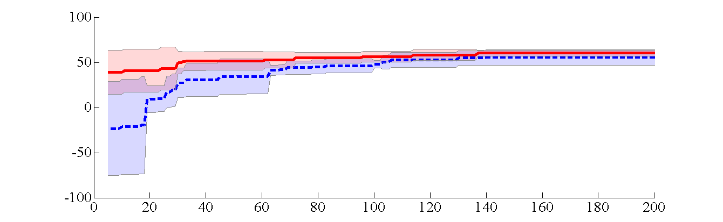
My Gamification Experience
Can human beings achieve higher convergence rate in solving NP problems than a computer solver? – No
Can human beings help to improve the algorithm?
Performance comparison on a longer track
Algorithm search only within the region of predicted successful plays lead to earlier good solutions on a variety of track settings
100
With player knowledge
Without player knowledge
Ren, Y., Bayrak, A., & Papalambros, P. Y. (2016). Ecoracer: Optimal Design and Control of Electric Vehicles Using Human Game Players. Journal of Mechanical Design, 138, 061407. (Best paper in design automation, IDETC2015)
-100
0
Iteration
200

Slide 14
My Gamification Experience
Can human beings achieve higher convergence rate in solving NP problems than a computer solver? – Not really
Can human beings help to improve the algorithm?
Yes…but human plays also take time!
The computer can teach itself equally well after enough plays.
There is a sweet spot along the time line when gamification is useful.

Slide 15


My Gamification Experience
- Current research: Models and algorithms to enable the integration of human knowledge in searching for solutions and the computational power.
Computer picks up the knowledge and solves the problem
Human teaches the strategy of solving problems

Slide 16
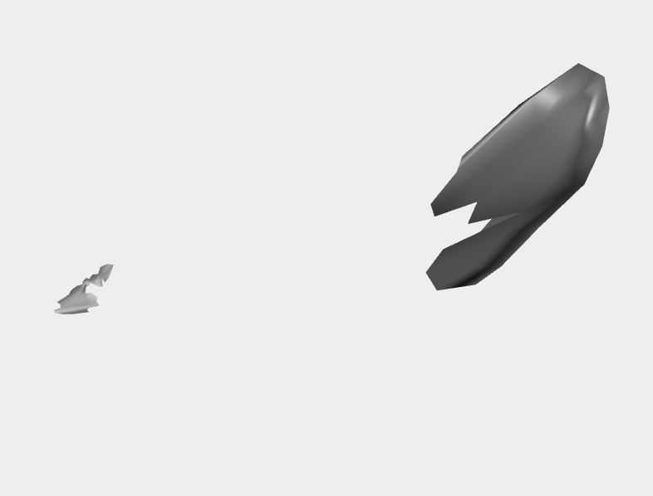
Current Development
Guess what this is?

Slide 17
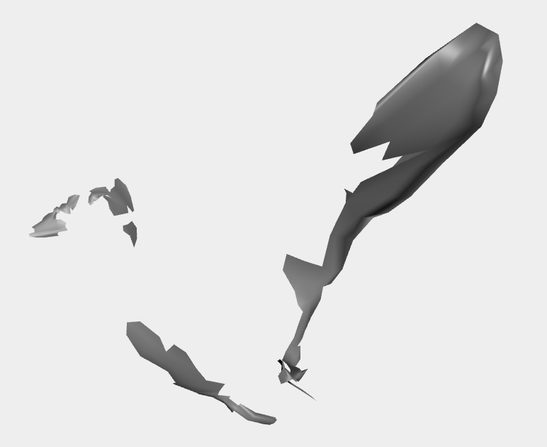
Current Development
Guess what this is?

Slide 18
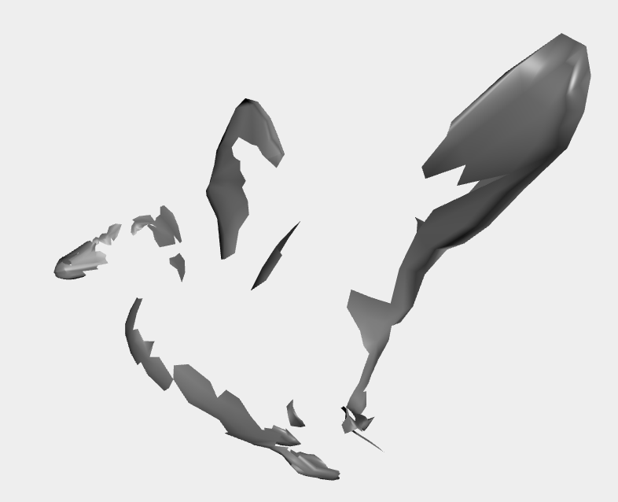
Current Development
Guess what this is?

Slide 19
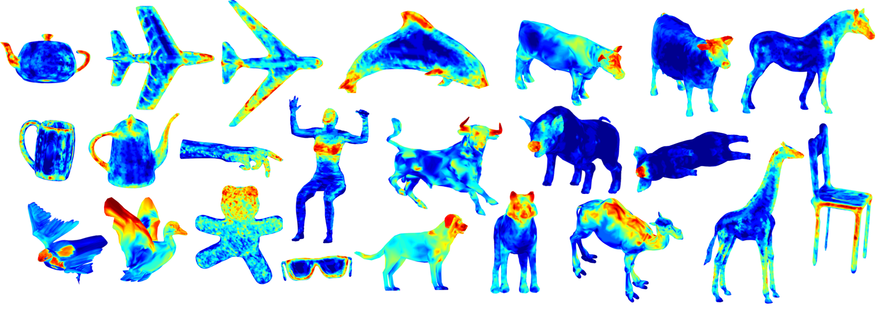
Current Development
Current project: Use shape saliency to improve recognition accuracy of RGBD data

Slide 20
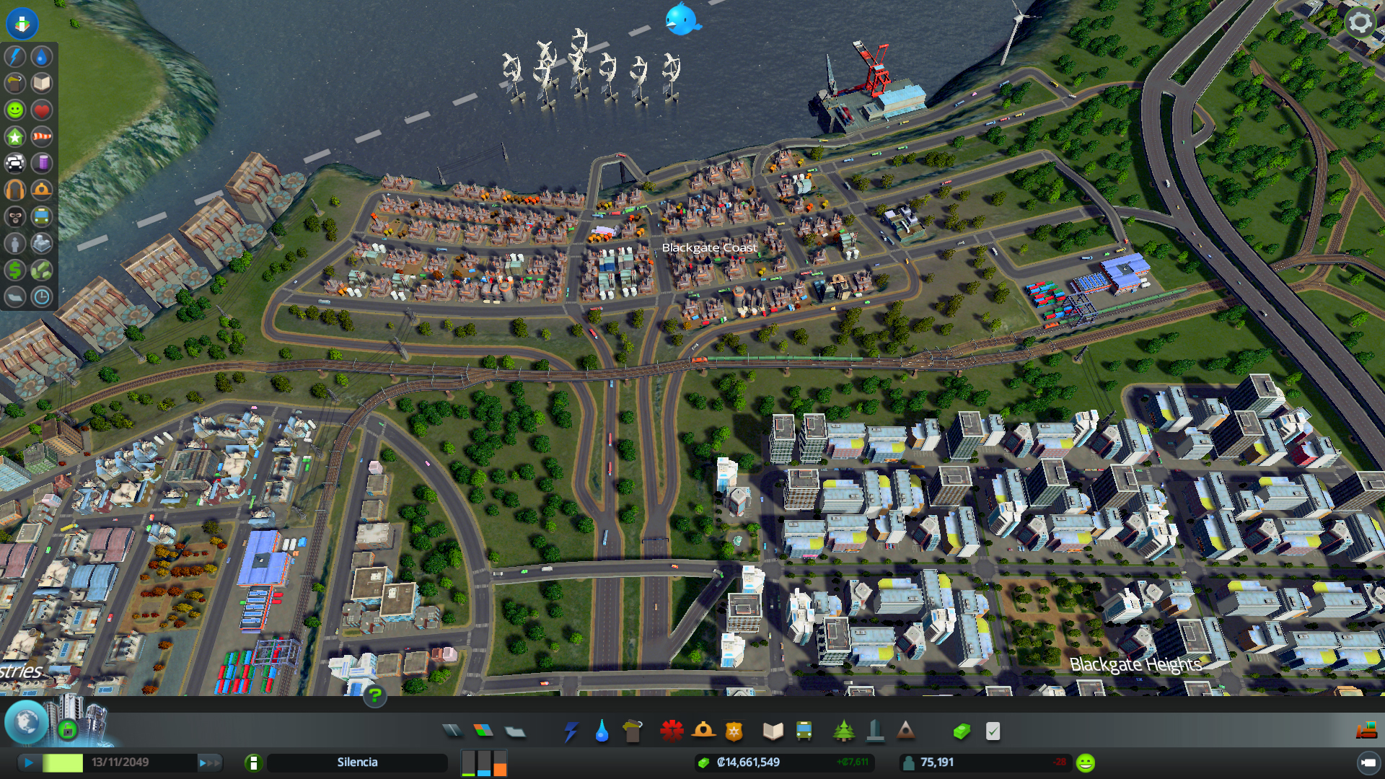
Current Development: Urban Planning
Cities: Skylines

